Slide 1
SHIFT REGISTERS: AN IN-DEPTH LOOK

Slide 2
TABLE OF CONTENTS
01
02
03
04
05
Introduction
Types of S-R
Overview of logic gates
Introduction to shift registers
Importance and applications of shift registers
Register Expansion Techniques
SISO / SIPO
PISO / PIPO
Introduction to register expansion
Cascading shift registers
Shifting data between multiple registers
Universal Shift Register
Serial vs. Parallel Data Transfer
Advantages and versatility
Circuit diagram and truth table
Operation and timing diagram
Comparison between serial and parallel data transfer
Factors influencing the choice of serial or parallel shift registers

Slide 3
INTRODUCTION
Logic gates are fundamental electronic components that perform logical operations, such as AND, OR, and NOT. Shift registers, on the other hand, are sequential circuits capable of storing and shifting binary data. They play a crucial role in digital systems, enabling tasks like data storage, manipulation, and transfer. Shift registers find applications in communication systems, computer memory, data processing, and more, offering advantages such as compactness, versatility, and the ability to handle large amounts of data.

Slide 4
02
Types of S-R

Slide 5
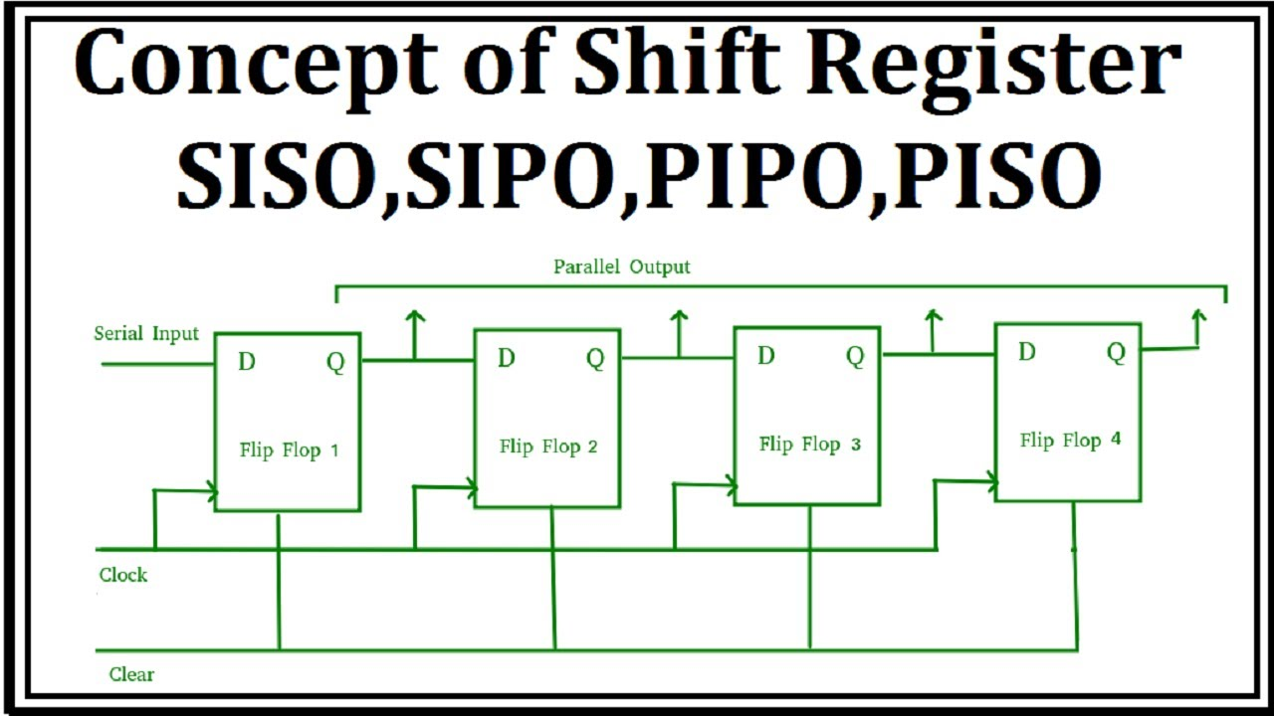
SISO | Serial-in, serial-out (SISO): Data is input serially and output serially.
SIPO | Serial-in, parallel-out (SIPO): Data is input serially and output in parallel.
PISO | Parallel-in, serial-out (PISO): Data is input in parallel and output serially.
PIPO | Parallel-in, parallel-out (PIPO): Data is input and output in parallel.

Slide 6
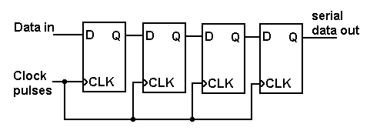
SISO Shift Register
The SISO shift register consists of a series of flip-flops, each connected to the next in a chain. The output of one flip-flop is connected to the input of the next flip-flop in the chain. The input to the first flip-flop is the serial input, and the output of the last flip-flop is the serial output.

Slide 7
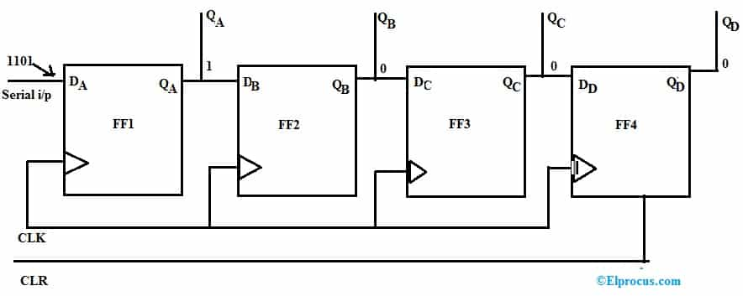
SIPO Shift Register
The SIPO shift register consists of a series of flip-flops, each connected to the next in a chain. The input to the first flip-flop is the serial input, and the outputs of all the flip-flops are connected together to form the parallel output.

Slide 8
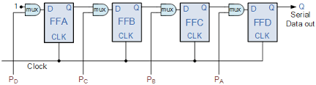
PISO Shift Register
The PISO shift register consists of a series of flip-flops, each connected to the next in a chain. The input to each flip-flop is connected to a separate input line, and the output of each flip-flop is connected to the input of the next flip-flop in the chain. The output of the last flip-flop in the chain is the serial output.

Slide 9
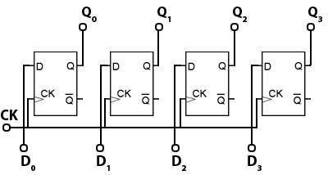
PIPO Shift Register
The PIPO shift register consists of a series of flip-flops, each connected to the next in a chain. The input to each flip-flop is connected to a separate input line, and the output of each flip-flop is connected to a separate output line. The input and output lines are typically grouped together to form parallel input and output ports.

Slide 10
03
Universal Shift Register

Slide 11
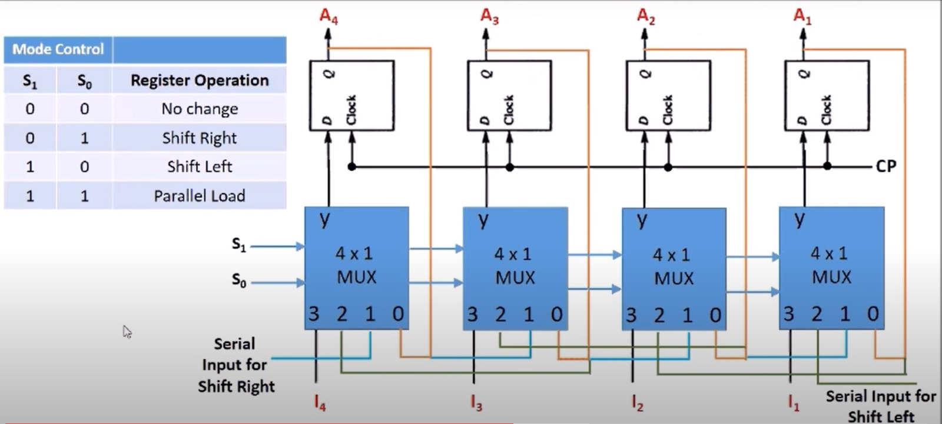
Universal Shift Register
The Universal Shift Register is a versatile sequential circuit that combines the functionalities of different types of shift registers. It offers the flexibility to shift data both serially and in parallel, making it suitable for various applications. The circuit diagram and truth table of a universal shift register illustrate the interconnection of flip-flops and the relationship between the inputs and outputs. The operation and timing diagram illustrate how the register handles both serial and parallel data transfer.

Slide 12
04
Serial vs. Parallel Data Transfer

Slide 13
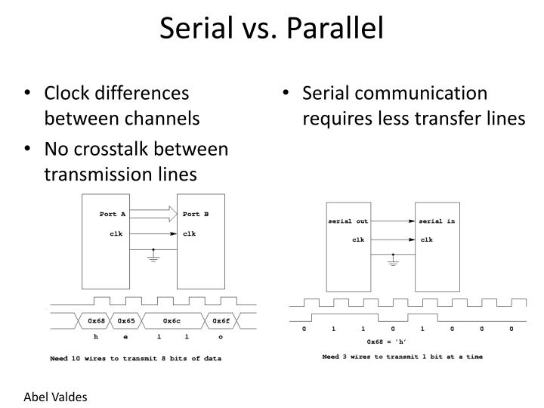
Serial vs. Parallel Data Transfer
Serial and parallel data transfer are two methods used for transmitting data in digital systems. Serial data transfer involves sending data one bit at a time over a single communication channel, while parallel data transfer involves sending multiple bits simultaneously over multiple channels. When comparing serial and parallel data transfer, factors such as the required transmission speed and the number of physical connections are important. Serial transfer is more cost-effective and suitable for space-constrained applications, while parallel transfer requires more wires.

Slide 14
05
Register Expansion Techniques

Slide 15
Register Expansion Techniques
Register expansion techniques are used to increase the capacity or functionality of shift registers in digital systems. Cascading shift registers increases the number of bits stored and shifted, while shifting data between multiple registers enables more complex data manipulation or parallel data processing operations. These techniques provide flexibility and scalability in designing systems that require expanded register capabilities.

Slide 16
Thank You
MAHMOUD SAMY - 211001642
MARWAN MAGED - 211000328
ANDREW FAYEK - 211001767
TAFWIK OSAMA - 21001717

